Slide 1

Creating Applications that can See, Hear, Speak and Understand Using Azure Cognitive Services
<NAME>- <TITLE/COMPANY>
<TwitterHandle/Social>

Slide 2
“Azure Cognitive Services can help me build Intelligent Applications”

Slide 3
“I can customize some services to build bespoke applications”

Slide 4
“Intelligence is powerful when it’s a full solution”

Slide 5
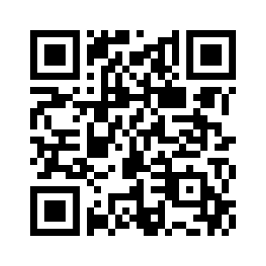
Azure Cognitive Services Creating applications that can see, hear, speak and understand
Build it Yourself
https://aka.ms/ai-nights-beginner

Slide 6
Customized language understanding
Text-to-speech
Content moderation
Spell check
Speech translation
AI
Custom image classification
Speaker recognition
Entity linking & augmentation
Sentiment analysis, key phrase extraction
Vision
Speech
Language
Image tagging
Custom voice
Object detection
Text translation
Intend analysis
OCR handwriting recognition
Emotion detection
Video insights
Custom translation
Face identification
Assisted text moderation
Custom speech
Speech transcription
Notes:
Simply put, AI represents the ability to take a lot of data that you have, and to teach machines to make intelligent predictions on it. These are some of the most common use cases:
For example, Computer vision is enabling organizations to use images and video to change the way they handle a variety of scenarios to enable things like facial recognition and object detection.
Additionally, speech is enabling organizations to transcribe Speech-to-Text, or enable natural sounding Text-to-Speech in a seamless and easy manner
Finally, Language is the ability to not only transcribe, but to also understand what the intent of the user is, and how to create a flow of dialog.

Slide 7


Azure AI
a
b
c
AI apps & agents
Knowledge mining
Machine learning
Azure Bot Service
Azure Cognitive Services
Azure Cognitive Search
Azure Databricks
Azure Machine Learning
Azure AI Infrastructure
Notes:
There are three main solutions you can build with Azure AI.
Build AI apps and agents that have the ability to interact with users naturally, with pre-trained AI models and bots
Unlock insights lying latent in your content with Knowledge Mining
Build your own AI machine learning models
As you can see we’ve also outlined the main products for each of these solutions areas.

Slide 8

Azure AI
a
b
c
AI apps & agents
Knowledge mining
Machine learning
Azure Bot Service
Azure Cognitive Services
Azure Cognitive Search
Azure Databricks
Azure Machine Learning
Azure AI Infrastructure
Notes:
We will focus on AI apps & Agents and specifically the Azure Cognitive Services

Slide 9
Building AI apps & agents
Azure AI
Vision
Speech
Your apps
Language
Azure Bot Service
Azure Cognitive Services
Azure Cognitive Search
Azure Databricks
Azure Machine Learning
Azure AI Infrastructure
Notes:
What is an AI App or AI agent and how do you build one?
The simplest way to get started is to take your existing web and mobile applications and add Vision, Speech, Language capabilities to them using AI models we’ve built.
Build processes to trigger the intelligence to make your customers/users more productive

Slide 10



Option 1
idea
prebuilt AI
reality

Slide 11





Azure Cognitive Services
Vision
Speech
Language
Decision
Search
Recognize, identify, caption, index, and moderate your pictures, videos, and digital ink content.
Convert spoken audio into text, use voice for verification, or add speaker recognition to your app.
Allow your apps to process natural language with pre-built scripts, evaluate sentiment and learn how to recognize what users want.
Build apps that surface recommendations for informed and efficient decision-making.
Add Bing Search APIs to your apps and harness the ability to comb billions of webpages, images, videos, and news with a single API call.
Give your apps a human side
Notes:
Azure Cognitive Services provide the most comprehensive set of pre-built AI technologies that are easily accessible via RESTful APIs. Azure Cognitive Search integrates with Azure Cognitive Services to enrich the data found in your documents.

Slide 12
Azure Cognitive Services
Vision
Speech
Language
Decision
Search
Video Indexer
Speaker Recognition
Text Analytics
Anomaly Detector
Bing Entity Search
Computer Vision
Speech Services
Bing Spell Check
Content Decision
Bing Autosuggest
Face
Translator Text
Personalizer
Bing Web Search
Custom Vision
QnA Maker
Bing Visual Search
Form Recognizer
Language Understanding
(LUIS)
Bing Video Search
Ink Recognizer
Bing Custom Search
Bing News Search
Bing Image Search
Bing Local Business Search
Give your apps a human side
Notes:
[This is the latest based on ACOM]
Azure Cognitive Services provide the most comprehensive set of pre-built AI technologies that are easily accessible via RESTful APIs.

Slide 13







Why Azure Cognitive Services?
Easy
Flexible
Tested
Roll your own with REST APIs
Simple to add: just a few lines of code required
Integrate into the language and platform of your choice
Breadth of offerings helps you find the right services for your app
Bring your own data for your custom experience
Built by experts in their field from Microsoft Research, Bing, and Azure Machine Learning
Quality documentation, sample code, and community support
Get a key,
Build
Notes:
Why choose these APIs ? They work, and it’s easy.
Easy: The APIs are easy to implement because of the simple REST calls. Being REST APIs, there’s a common way to implement and you can get started with all of them for free simply by going to one place, one website, www.microsoft.com/cognitive. (You don’t have to hunt around to different places.)
Flexible: We’ve got a breadth of intelligence and knowledge APIs so developers will be able to find what intelligence feature they need; and importantly, they all work on whatever language, framework, or platform developers choose. So, devs can integrated into their apps—iOS, Android, Windows—using their own tools they know and love (such as python or node.js, etc.).
Tested: Tap into an ever-growing collection of powerful AI algorithms developed by experts. Developers can trust the quality and expertise build into each by experts in their field from Microsoft’s Research organization, Bing, and Azure machine learning and these capabilities are used across many Microsoft first party products such as Cortana, Bing and Skype.

Slide 14
Demo Azure Cognitive Services
https://aka.ms/ai-nights-beginner

Slide 15






Cognitive Services Containers
Now In Public Preview
No app changes & Compatible with full Cognitive Services feature-set
Support for 6 key AI capabilities:
Key Phrase Extraction
Language Detection
Sentiment Analysis
Face & Emotion Detection
OCR / Text Recognition
Language Understanding
Run & manage locally, Try for free
Connect to Billing service for report back, unified billing with on-cloud and off-cloud transactions
Additional Capabilities coming soon (e.g. Speech)

Slide 16

Option 2
idea
customize
prebuilt AI
reality

Slide 17

Custom Vision A customizable web service that learns to recognize specific content in imagery
Upload images
Upload your own labeled images, or use Custom Vision Service to quickly tag any unlabeled images
Train
Use your labeled images to teach Custom Vision Service the concepts you want it to learn
Evaluate
Use simple REST API calls to quickly tag images with your new custom computer vision model
Active learning
Images evaluated through your custom vision model become part of a feedback loop you can use to keep improving your classifier
Notes:
An easy-to-use, customizable web service that learns to recognize specific content in imagery, powered by state-of-the-art machine learning neural networks that become smarter with training. You can train it to recognize whatever you choose, whether that be animals, objects, or abstract symbols. This technology could easily apply to retail environments for machine-assisted product identification, or in digital space to automatically help sorting categories of pictures.

Slide 18
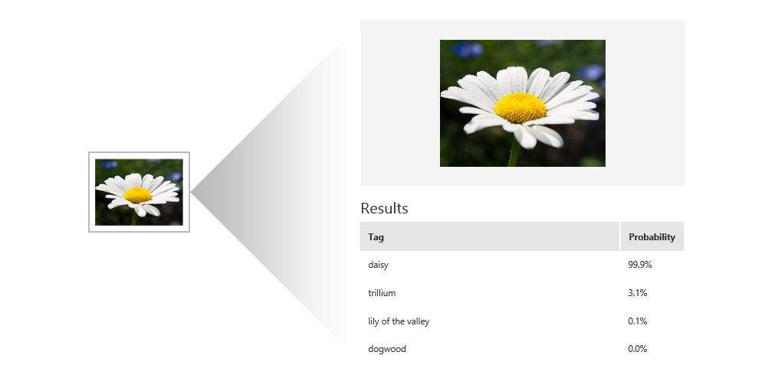
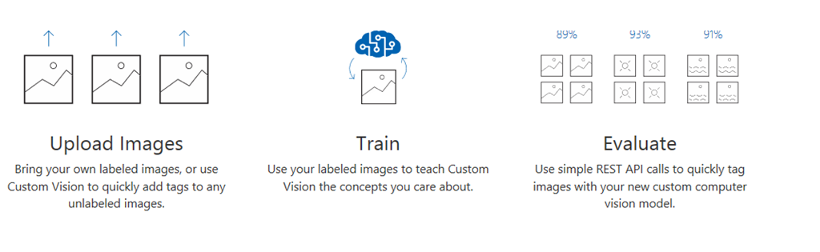
Custom Vision

Slide 19
Demo Azure Custom Vision
https://aka.ms/ai-nights-beginner

Slide 20
History of cloud development
Increasingly advanced cloud technologies have led companies to entrust more and more of their IT activities to service providers
On-premises
IaaS
PaaS
Serverless
Servers & storage
Security
OS & software
Dev tools
Apps & services

Slide 21


What is serverless?
Full abstraction of servers
Developers can just focus on their code—there are no distractions around server management, capacity planning, or availability.
Instant, event-driven scalability
Application components react to events and triggers in near real-time with virtually unlimited scalability; compute resources are used as needed.
Pay-per-use
Only pay for what you use: billing is typically calculated on the number of function calls, code execution time, and memory used.*
*Supporting services, like storage and networking, may be charged separately.

Slide 22








Azure Serverless Ecosystem
Development
Platform
IDE support
Event Grid
Functions
Logic Apps
Manage all events that can trigger code or logic
Execute your code based on events you specify
Design workflows and orchestrate processes
Integrated DevOps
Local development
Monitoring
Database
Storage
Analytics
Intelligence
Security
IoT
Visual debug history

Slide 23
Demo Custom Vision and Logic Apps
https://aka.ms/ai-nights-beginner

Slide 24
Azure Cognitive Services can help me build intelligent applications
Azure Cognitive Services
I can customize some services to build bespoke applications
Intelligence is powerful when it’s a full solution

Slide 25
Azure Logic Apps Documentation: https://aka.ms/gaib-logicapps
Azure Cognitive Services
Azure Cognitive Services Documentation: https://aka.ms/gaib-cognitive
Azure Custom Vision Service:
https://aka.ms/gaib-customvision

Slide 26
Azure Cognitive Services Creating applications that can see, hear, speak and understand
Build it Yourself
https://aka.ms/ai-nights-beginner

Slide 27
Creating Applications that can See, Hear, Speak and Understand Using Azure Cognitive Services
<NAME>- <TITLE/COMPANY>
<TwitterHandle/Social>

